Slide 1


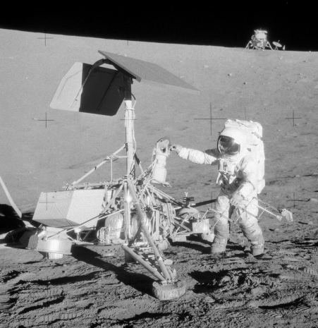
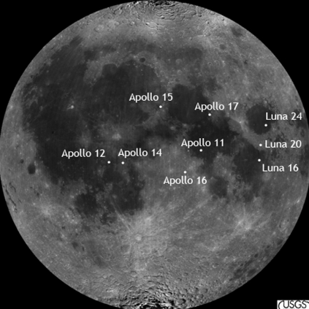

Lunar exploration
Helin Lei
20594501

Slide 2

Content
4
1
Setting
Test
2
5
Ideation cards
Reflect
3
Prototype

Slide 3
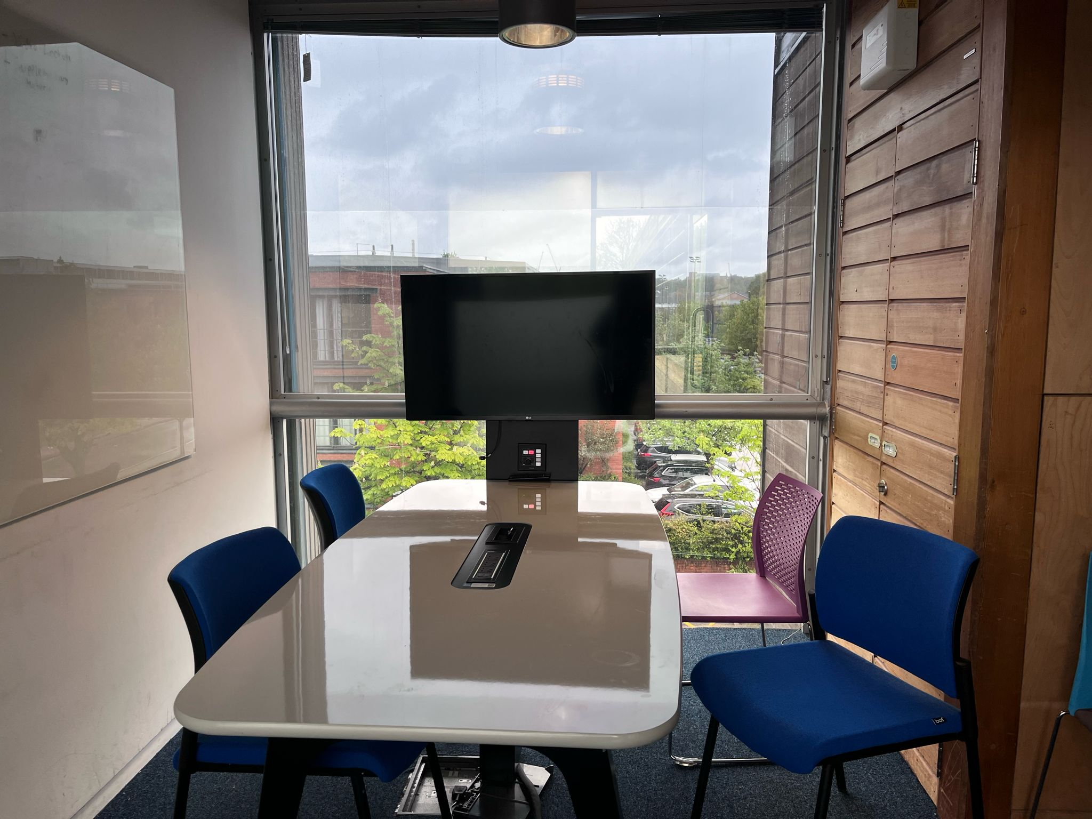
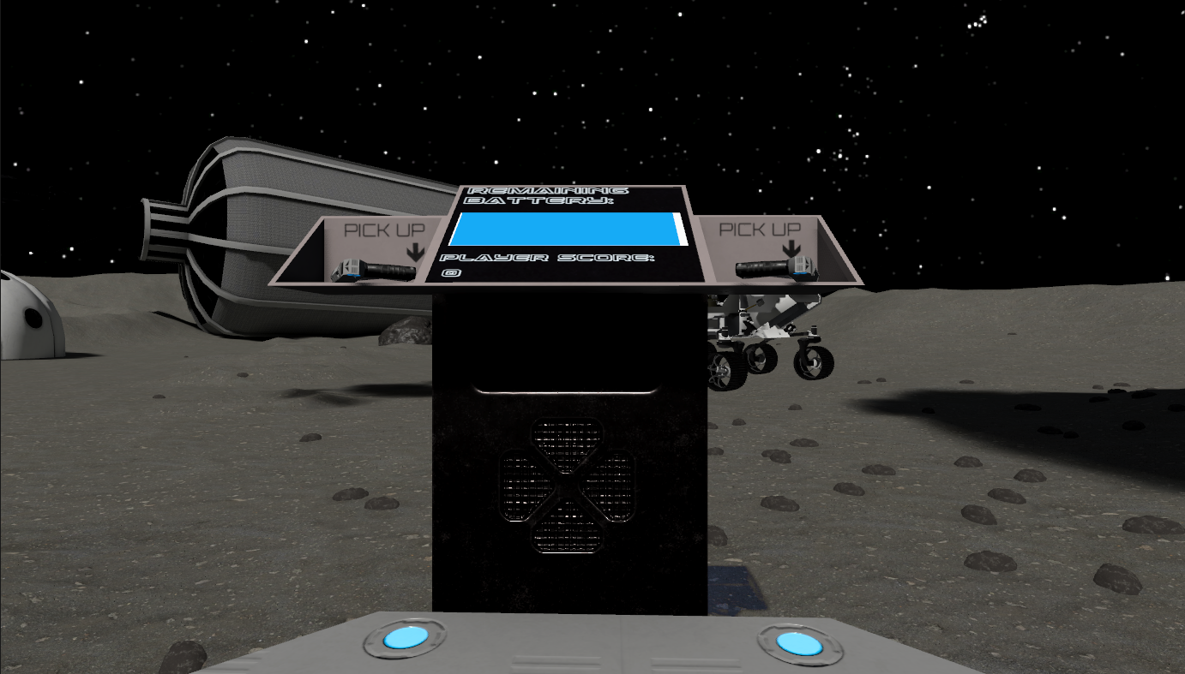
Setting-STUDYSPACE

Slide 4
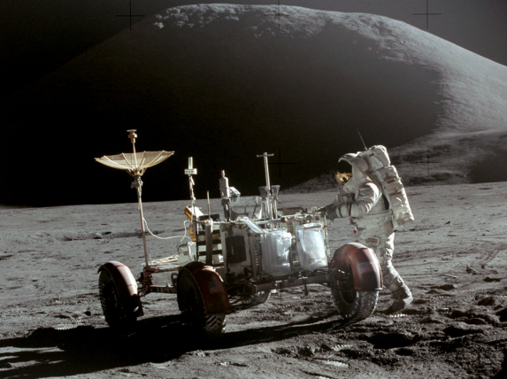
Setting-MOON
Safely explore lunar environment
Popularize space knowledge^{[1][2]}
[1] Crawford, I. A., Joy, K. H., & Anand, M. (2014). Lunar Exploration. In T. Spohn & D. Breuer (Eds.), Encyclopedia of the Solar System (3rd ed., pp. 555-579). Elsevier. http://dx.doi.org/10.1016/B978-0-12-415845-0.00025-6
[2] Zakrajsek, J. J., McKissock, D. B., Woytach, J. M., Zakrajsek, J. F., Oswald, F. B., McEntire, K. J., Hill, G. M., Abel, P., Eichenberg, D. J., & Goodnight, T. W. (2005). Exploration Rover Concepts and Development Challenges. NASA/TM—2005-213555. Glenn Research Center, Cleveland, Ohio. Retrieved from http://gltrs.grc.nasa.gov

Slide 5
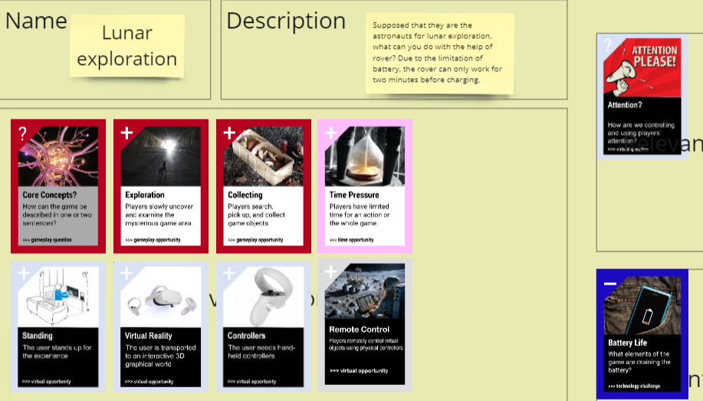

Ideation cards

Slide 6
Prototype

Slide 7

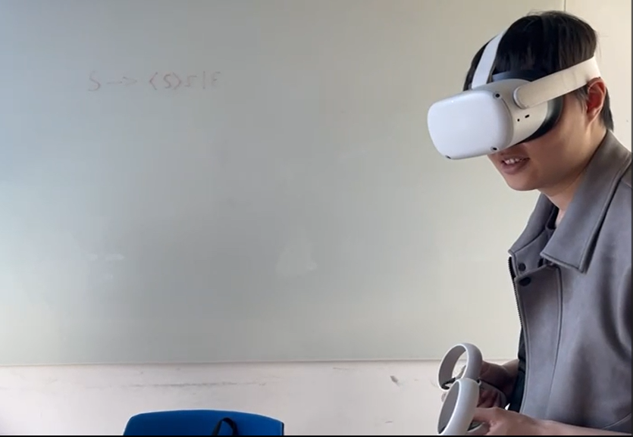
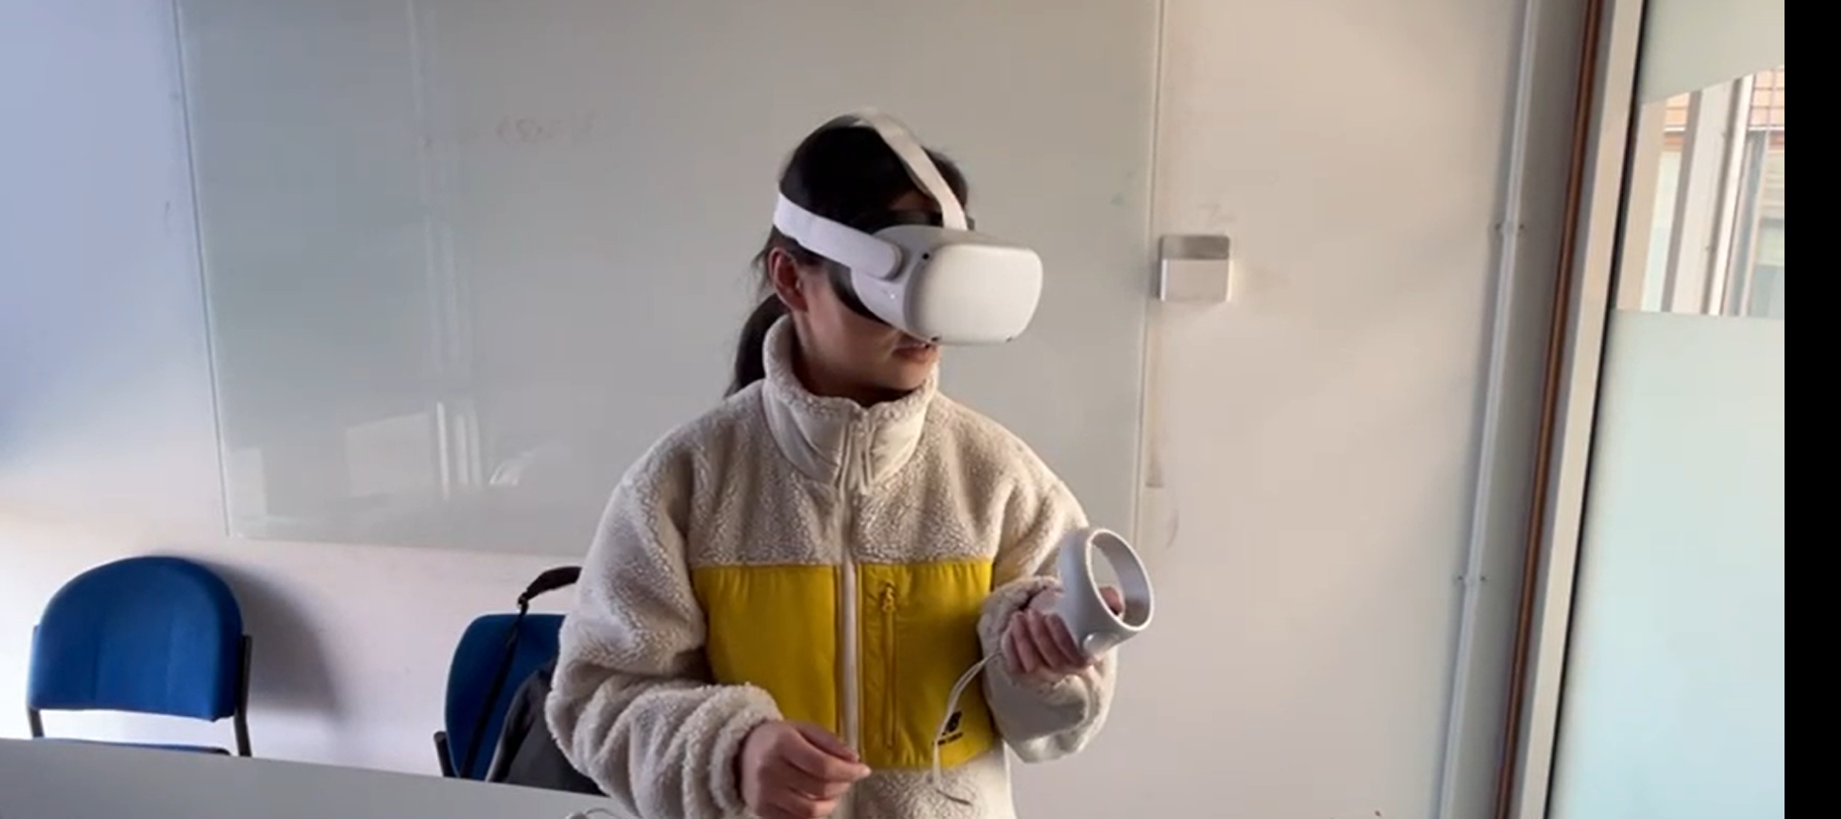
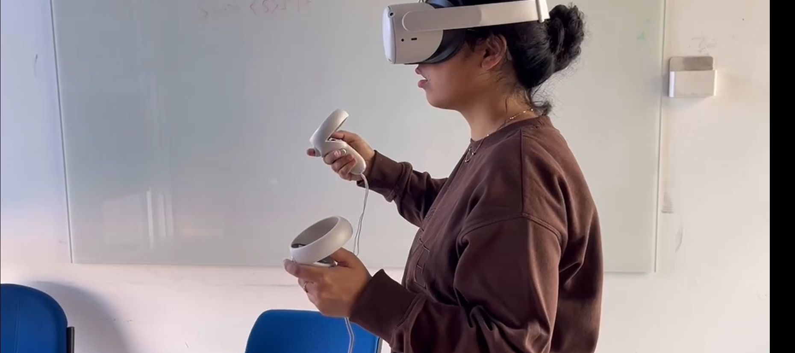
Test
Like the Lunar environment

Slide 8
Reflect
What senses do we need/want to engage in a given context?
What’s the cost/benefit of stimulating them (not financially
but in terms of immersion)?
How to know how to focus attention and then direct resources there while minimising distractions?

Slide 9

Thank
you!

